Slide 1

Software Design and Analysis Timing Diagram
Department of Computer Science
National University of Computer and Emerging Sciences

Slide 2
UML Timing Diagram
In UML, the timing diagrams are a part of Interaction diagrams that do not incorporate similar notations as that of sequence and collaboration diagram.
It consists of a graph or waveform that depicts the state of a lifeline at a specific point of time.
It illustrates how conditions are altered both inside and between lifelines alongside linear time axis.

Slide 3
UML Timing Diagram
The timing diagram describes how an object underwent a change from one form to another.
A waveform portrays the flow among the software programs at several instances of time.

Slide 4
UML Timing Diagram
Following are some important key points of a timing diagram:
It emphasizes at that particular time when the message has been sent among objects.
It explains the time processing of an object in detail.
It is employed with distributed and embedded systems.
It also explains how an object undergoes changes in its form throughout its lifeline.
As the lifelines are named on the left side of an edge, the timing diagrams are read from left to right.
It depicts a graphical representation of states of a lifeline per unit time.
In UML, the timing diagram has come up with several notations to simplify the transition state among two lifelines per unit time.

Slide 5
Basic concepts of a Timing Diagram
In UML, the timing diagram constitutes several major elements, which are as follows:
Lifeline
As the name suggests, the lifeline portrays an individual element in the interaction.
It represents a single entity, which is a part of the interaction.
It is represented by the classifier's name that it depicts.
A lifeline can be placed within a "swimlane" or a diagram frame.

Slide 6
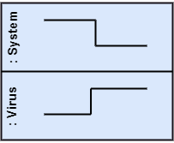
Basic concepts of a Timing Diagram
Lifeline
Lifelines representing instances of a System and Virus

Slide 7
Basic concepts of a Timing Diagram
State or Condition Timeline
The timing diagram represents the state of a classifier or attributes that are participating, or some testable conditions, which is a discrete value of the classifier.
In UML, the state or condition is continuous.
It is mainly used to show the temperature and density where the entities endure a continuous state change.

Slide 8
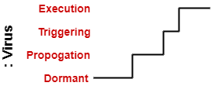
Basic concepts of a Timing Diagram
State or Condition Timeline
Timeline showing the change in the state of virus between dormant, Propagation, Triggering, Execution

Slide 9
Basic concepts of a Timing Diagram
Duration Constraint
The duration constraint is a constraint of an interval, which refers to duration interval.
It is used to determine if the constraint is satisfied for a duration or not. The duration constraint semantics inherits from the constraints.
The negative trace defines the violated constraints, which means the system is failed.
A graphical association between duration interval and the construct, which it constrains, may represent a duration constraint.

Slide 10
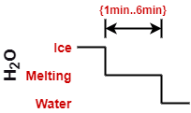
Basic concepts of a Timing Diagram
Duration Constraint
Ice should melt into the water in 1 to 6 mins.

Slide 11
Basic concepts of a Timing Diagram
Time Constraint
It is an interval constraint, which refers to the time interval. Since it is a time expression, it depicts if the constraint is satisfied or not. The constraints dispense its time constraints semantics.
The negative trace defines the violated constraints, which means the system is failed.
The time constraint is represented by a graphical association between the time interval and the construct which it constrains.
The graphical association is mainly represented by a small line in between a time interval and an occurrence specification.

Slide 12

Basic concepts of a Timing Diagram
Time Constraint
A person should wakeup in between 5:40 am, and 6 am

Slide 13
Basic concepts of a Timing Diagram
Destruction Occurrence
The destruction occurrence refers to the occurrence of a message that represents the destruction of an instance is defined by a lifeline.
It may subsequently destruct other objects owned by the composition of this object, such that nothing occurs after the destruction event on a given lifeline.
It is represented by a cross at the end of a timeline.

Slide 14
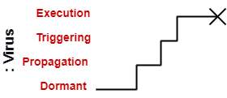
Basic concepts of a Timing Diagram
Destruction Occurrence
Virus lifeline is terminated

Slide 15
Example of a Timing Diagram
A timing diagram example of a medical domain
that depicts different stages of Alzheimer's disease (AD) is explained below.
Since Alzheimer's is a very progressive fatal brain disease, it leads to memory loss and intellectual abilities. The reason behind this disease is yet to be discovered.
It cannot be cured as well as one of the main reasons for rising death rates in the United States.
The doctor may require a diagnostic framework with three to seven-stage, such that its evolution may last for about 8 to 10 years.
Also, in some cases, it lasts up to 20years from the time neuron starts changing.

Slide 16
Example of a Timing Diagram
The example given below constitutes timing for a seven-stage framework.
The given example is just a UML diagram
and should not be considered as a reference to medical research.
The medical details are provided for you to better understand the UML diagram.

Slide 17
Example of a Timing Diagram
Following are the seven-stage Alzheimer disease framework explained below:
No Impairment, Normal State It is the stage where the memory and cognitive abilities look normal.
Normal Aged Forgetfulness It is mostly seen in people with an age group of 65 who experience subjective complaints of cognitive and/or functional difficulties, which means they face problems in recalling the name and past 5 to 10 years of history. Duration 2.7 years
Early Confusional, Mild Cognitive Impairment It causes a problem in retrieving words, planning, organizing, objects misplacing as well as forgetting fresh learning, which in turn affects the surrounding. Duration 2.2s years

Slide 18
Example of a Timing Diagram
Following are the seven-stage Alzheimer disease framework explained below:
Late Confusional, Mild Alzheimer's In this, a person forgets the most recent events and conversations. The person remembers himself and his family, but face problems while carying out sequential tasks such as cooking, driving, etc. Its duration is about two years.
Early Dementia, Moderate Alzheimer's In this, the person cannot manage independently. He faces difficulty in recalling the past details and contact information. It lasts for about 1.5 years.
Middle Dementia, Moderately Severe Alzheimer's It leads to insufficient awareness about current events, and the person is unable to recall the past. It causes an inability in people to take a bath and dress up independently. It lasts for about 2.5 years approximately.

Slide 19
Example of a Timing Diagram
Following are the seven-stage Alzheimer disease framework explained below:
Late or Severe Dementia, Failure to Thrive It is severely limited intellectual ability. In this, a person either communicates through short words or cries, which leads health to decline as it shut down the body system. Its duration is 1 to 2.5 years.

Slide 20
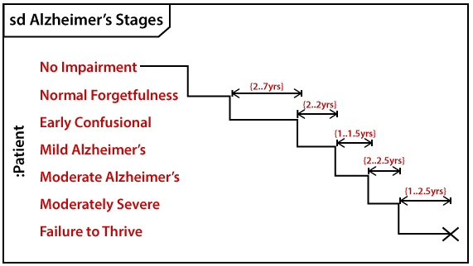
Example of a Timing Diagram

Slide 21
Benefits & Drawbacks of a Timing Diagram
Benefits of Timing Diagram
It depicts the state of an object at a particular point in time.
It implements forward and reverses engineering.
It keeps an eye on every single change that happens within the system.
Drawbacks of Timing Diagram
It is hard to maintain and understand.

Slide 22
4+1 View
The "4+1 view model" is a software architecture and design approach used to describe complex software systems from multiple perspectives.
It is a variation of the more well-known "4+1 Architectural View Model," which was developed by Philippe Kruchten and later extended to include the "+1" view.
The "4+1 view model" incorporates five concurrent views or perspectives to comprehensively describe and understand a software system:

Slide 23
4+1 View
1-Logical View: Definition: It focuses on Object-oriented decomposition, shows the key abstractions in the system as objects or object classes.
View: End user
UML Diagram: Class Diagram, State Diagram
2-Process View: Definition: It focuses on process decomposition. Shows how, at run time, the system is
composed of interacting processes.
View: Integrator
Considers: Non-functional requirements, useful for making judgements about non-functional system characteristics such as performance and availability.
UML Diagram: Activity Diagram

Slide 24
4+1 View
3- Development View: Definition: It focuses on subsystem decomposition. Shows how the software is decomposed for development. It shows the breakdown of the software into components that are implemented by a single developer or development team.
View: Programmers and Software Managers
Considers: Software module organization (hierarchy of layers, software management, reuse, constraints of tools)
4- Physical View: Definition: It focuses on mapping the software to the hardware. It shows how software components are distributed across multiple cores/processors in the system.
5- View: System engineers Considers: Non-functional requirements regarding underlying hardware (topology, communication)
UML Diagram: Deployment Diagram

Slide 25
4+1 View
* These views/perspectives can be linked through common use cases or scenarios.
Conceptual View: This view is an abstract view of the system that can be the basis for decomposing high-level requirements into more detailed specifications, help engineers make decisions about components that can be reused, and represent a product line rather than a single system.

Slide 26
End of Lecture Any Question ?

